Slide 1
BANKING LOAN ANALYSIS & Debit Credit ANALYSIS
Presented by
Group 6

Slide 2
TEAM MEMBER OF THE PROJECT
1.Priya
2.Rakesh Pothula
3.Shashank
4.Vishal Todkar
5.Pavan Kumar
6.Polepalle Sunil Kumar

Slide 3
Today Agenda
Introduction
Data Overview
Objectives :KPI’s
Process
Analysis
Recommendations and Insights
Conclusion

Slide 4
Introduction
This project main aim is to analysis the financial loan of customer along with debit and credit analysis of the customer. By using different tools such as excel SQL, Tableau and Power bi.
Key Metrics:-Loan Amounts Interest Rates Borrower profiles and financial situations.
Purpose:-Identifying trends in loan performance for debt consolidation, home improvement, education, small business funding,
and personal loans.
Outcome: we use for Analyzing, cleaning the data and removing duplicates if any from datasets and prepared dashboards
insights accurate business decisions are made.

Slide 5
Data Over view
Data Collection & Cleaning – Import loan data from Banking Data Analysis and Debit & Credit Banking Data
Data Transformation – Use SQL queries to extract key trends
Dashboard Creation – Develop dashboards in Excel, Power BI, and Tableau
KPI Analysis – Evaluate loan trends, repayment behaviour, and risk factors
Insight Generation & Reporting – Identify patterns and provide recommendations

Slide 6
Tools used in the Project
EXCEL
SQL
TABLEAU
POWER BI
Data Exploration
Data Cleaning
Visualization
Data Exploration
Retrieving
Relevant Data according to KPIs
Joining multiple Files
Visualization
Joining multiple Files
Data Exploration
Data Cleaning in Power Query
Visualization

Slide 7
Objectives of KPI’s
Yearly Loan Amount is not steadied form year to year
2017:$31.34M 2018:$223.67M 2019:-$185.10M 2020:$5.48M
2. Loan Grade loans is having more credit risk
3.While giving Loans & Credit card issue the having to check minimum Income returns
4.Average Verified Loan Payment is $17,167
5.Average Non-Verified Loan Payment is $9,074
6. Source Verified Loan Payment is $10,941
7. Average Credit card Transaction $2,549
8. Average Debit Card Transaction $2,553
9. Average Bank Transfer Transaction $2,543

Slide 8
Kpi 2- Grade & Subgrade status
Kpi 1- YEAR WISE LOAN AMOUNT STATUS
By Observing this chart the loan amount is increased by 2018 followed by 2019
The Loan Amount is up and down in every year
In 2020 due to corona this year loan is drastically reduced
By Observing this chart Low grade Loan is having more risk
For high grade loans bank has to concentrate on payments
In this grade and subgrade wise revel balance we can notice
Grade B have more revel balance then any other grades & grade
G have very low revel balance

Slide 9
KPI 4- Verified & Non verified Status
KPI 3- Verified & Non verified Status
In this chart we are observing that 32% of the Not Verified loan is provided by the banker
So bank has to more construct on this
Uttar Pradesh State is having 24% of the Loans and followed by
Punjab 21% of the loans
The banks has to more concentrate on Jharkhand To Tripura reducing
Loan % and remove processing fee

Slide 10
KPI 1- Bank Wise Debit & Credit Amount
By observing that HDFC using Debit & Credit card usage by compare with Other bank
So HDFC bank has to reduce the EMI Processing fee and provide more offer in Online
& Offline
KPI 1- Brance Wise Debit & Credit Transaton
City centre Brance issued Credit & Debit Transaction are more follow by
Downtown branch
North Branch & Suburban Brance usage is very less so while issuing
Debit & credit Card for this they have to verify Grading & Profile check

Slide 11
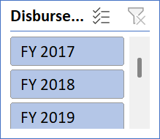
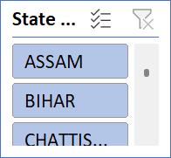
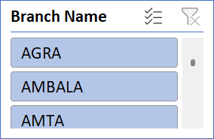
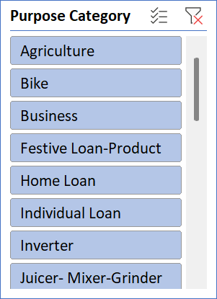
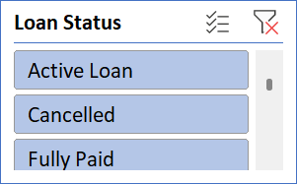
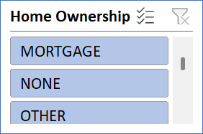
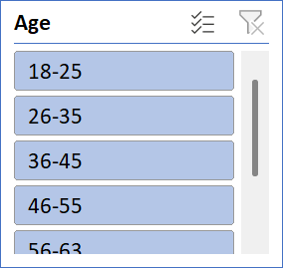
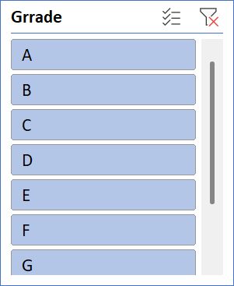
Excel Banking Loan Dash Board
Banking Loan Analysis
Total Loan Collection
750.97M
Total Loans Count
65535
Total Loan Funded Amount
732.97M
Total Loan Interest Received
155.81M

Slide 12
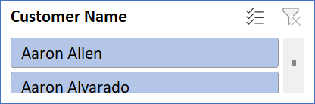
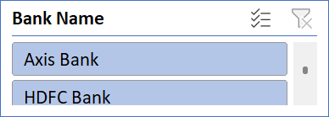
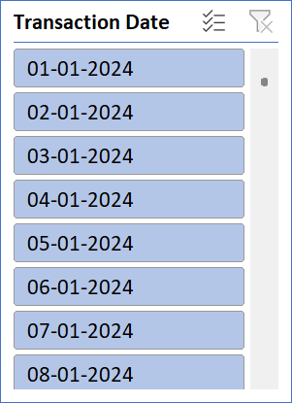

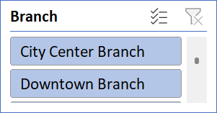
Excel Debit & Credit Banking Dashboard
Debit & Credit Banking Analysis Dash Board
Total Credit Amount
127603.39M
Total Debit Amount
190774.05M
Total Credit to Debit Ratio
66.89%

Slide 13
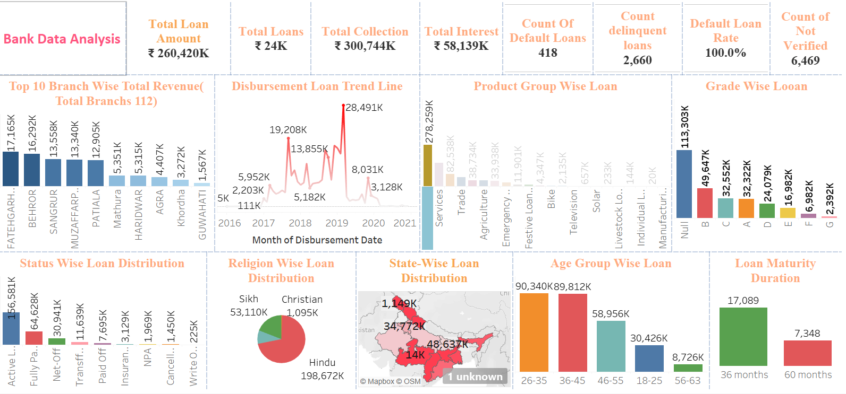
Tableau Loan Analysis Dash Board

Slide 14
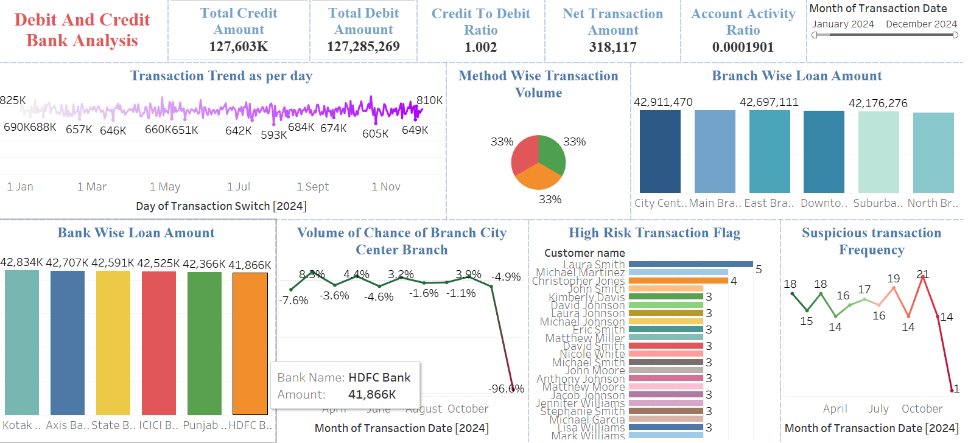
Tableau Credit & Debit Analysis Dash Board

Slide 15
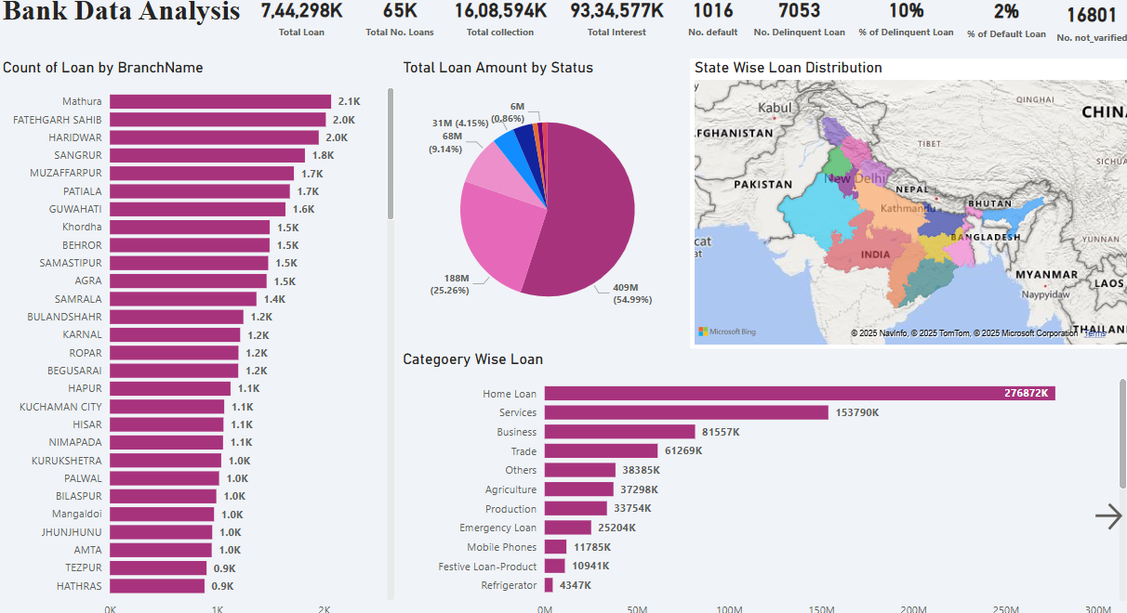
Power BI Loan Analysis Dash Board

Slide 16
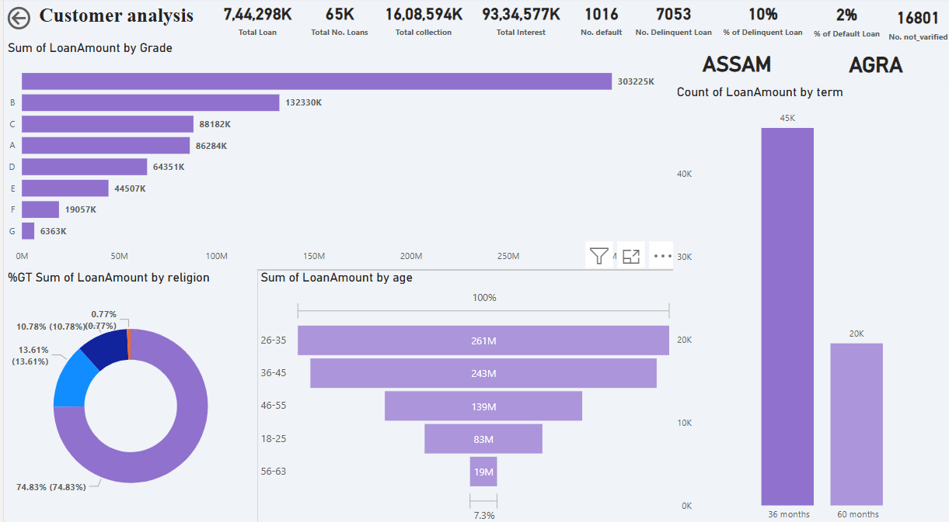
Power BI Customer Analysis

Slide 17
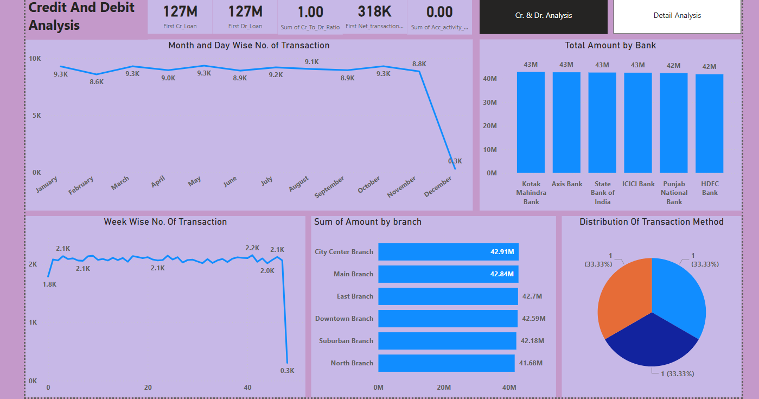
Power BI Credit & Debit Analysis Dash Board

Slide 18
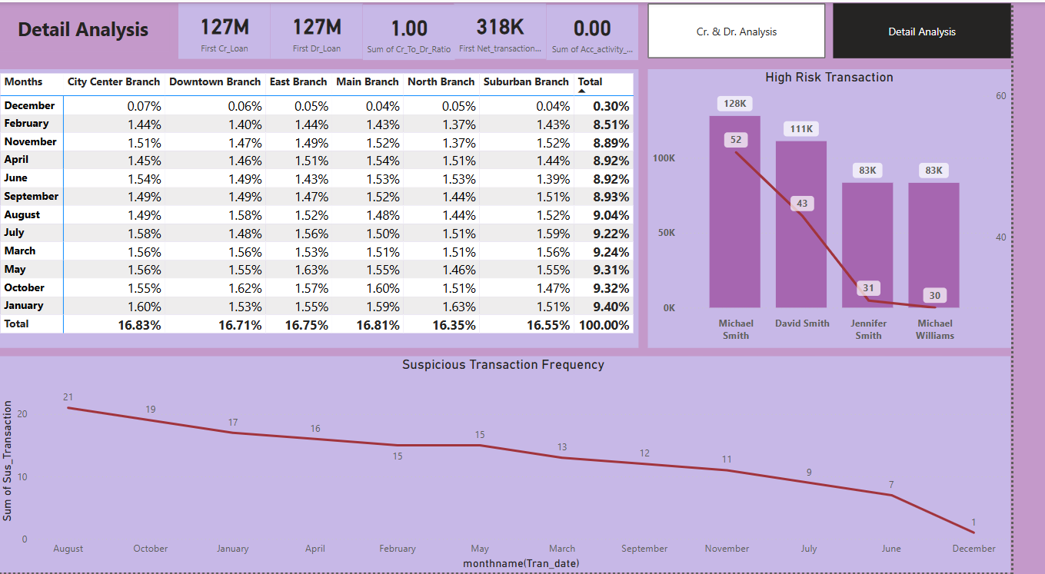
Power BI Detail Analysis Dash Board

Slide 19
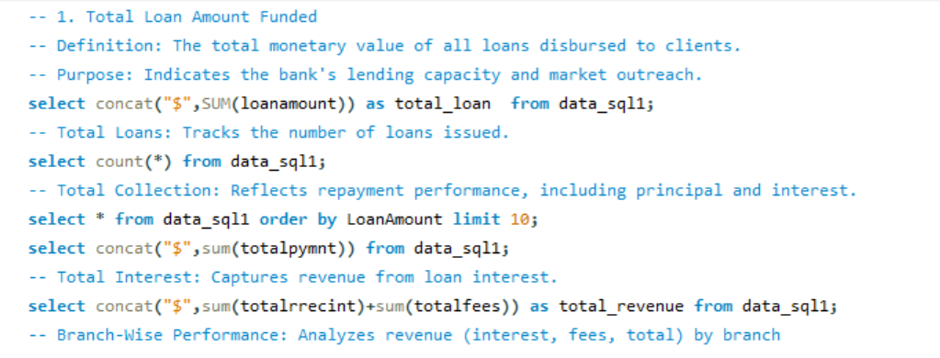
SQL Banking Loan & Debit Credit Dashboard

Slide 20
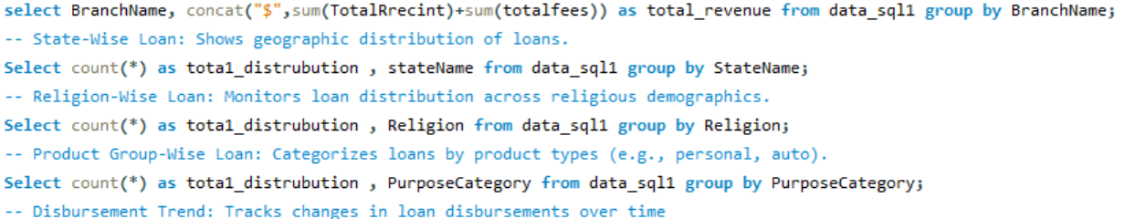
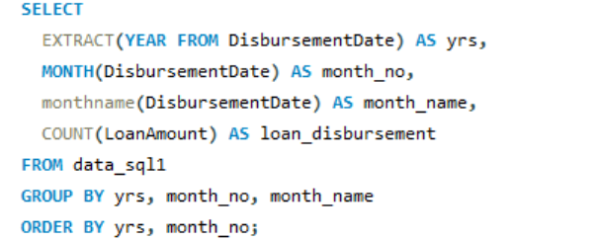
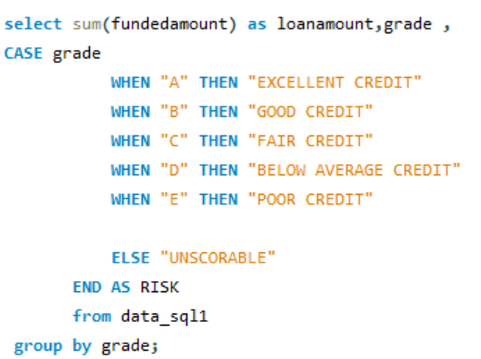

Slide 21
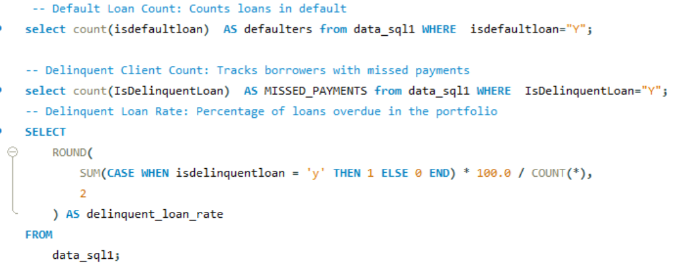
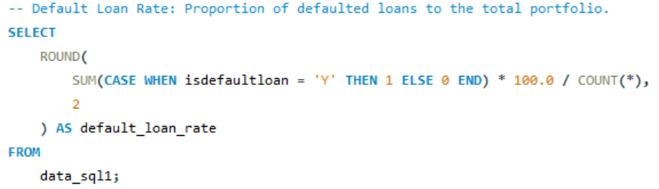

Slide 22
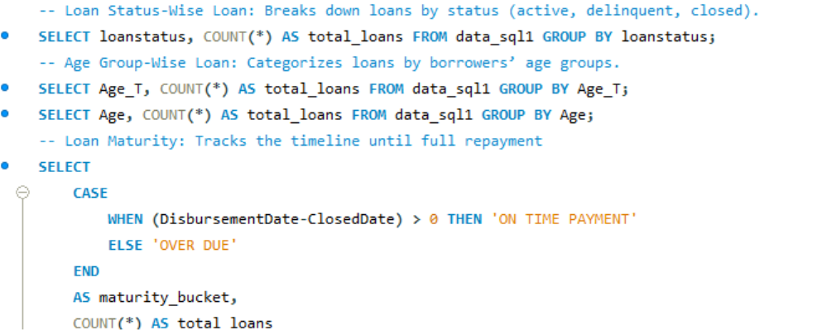
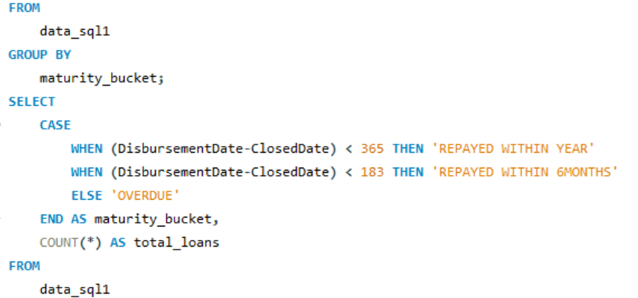

Slide 23
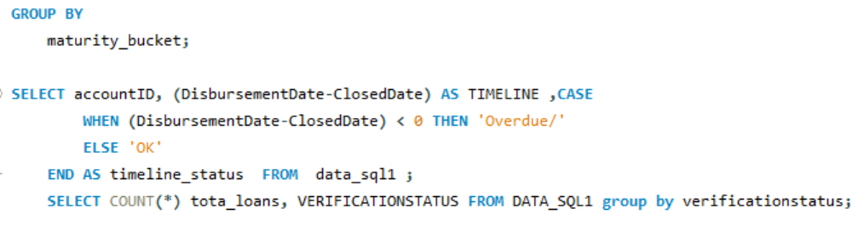
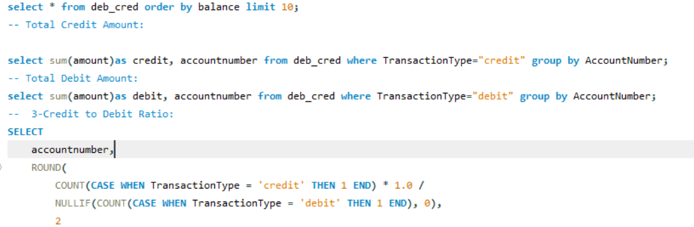

Slide 24
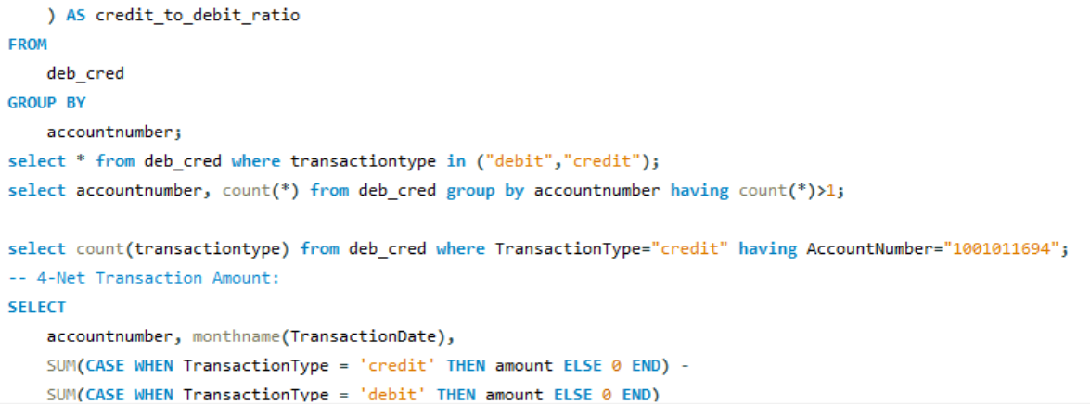
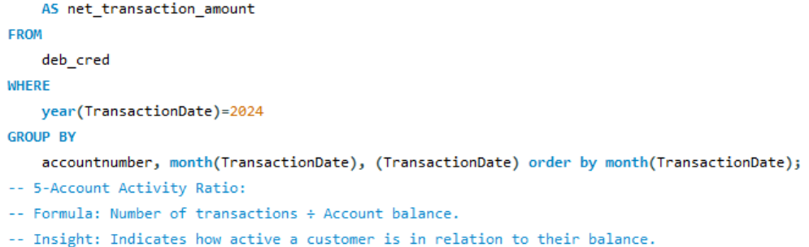

Slide 25
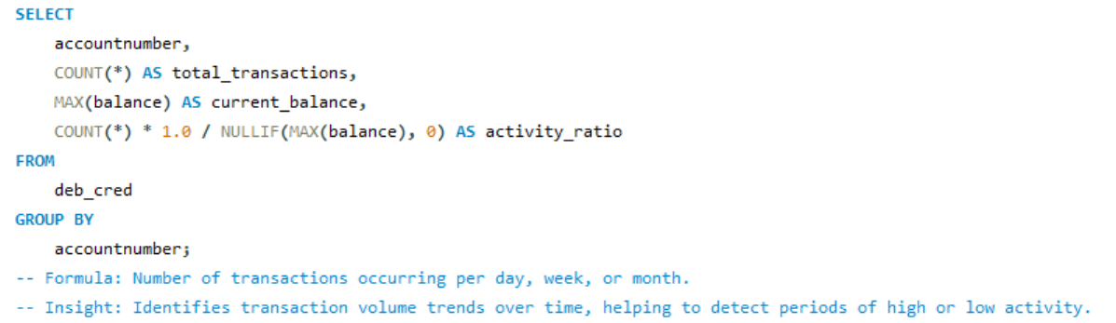
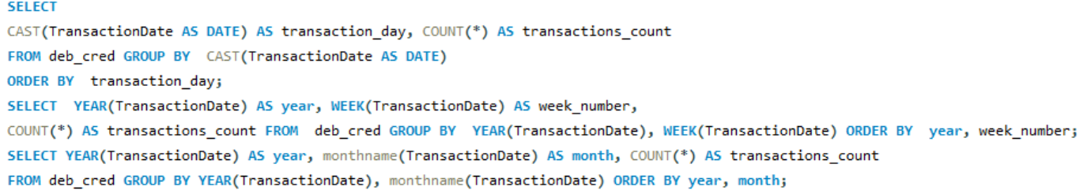

Slide 26
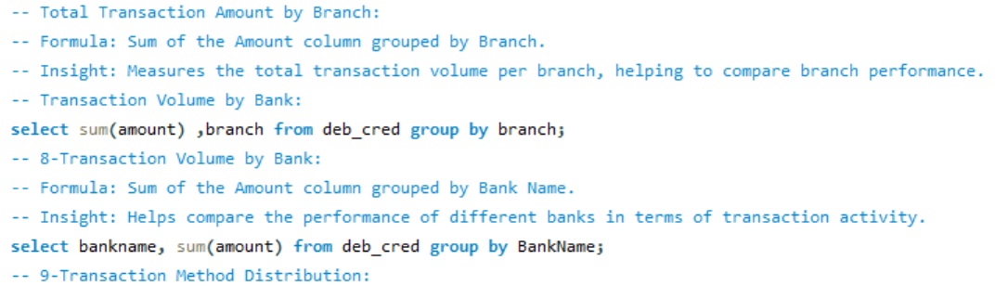
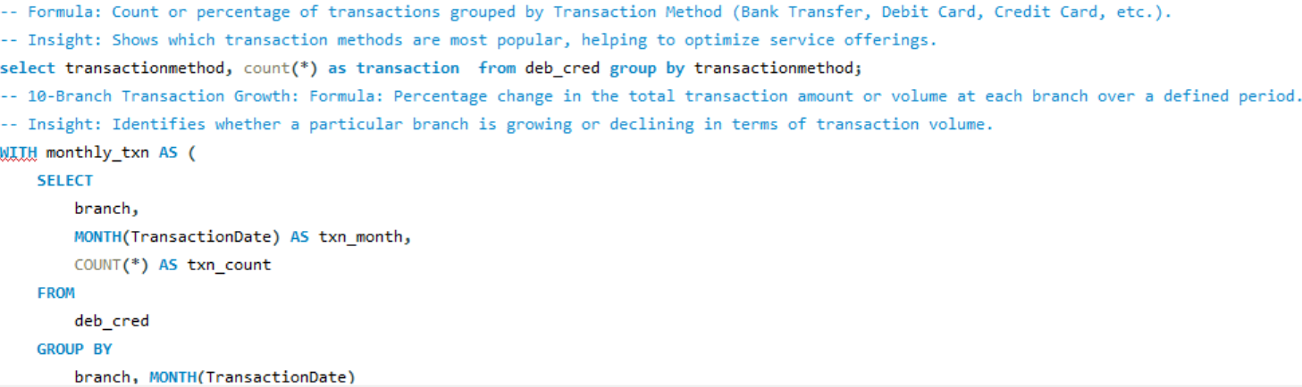

Slide 27
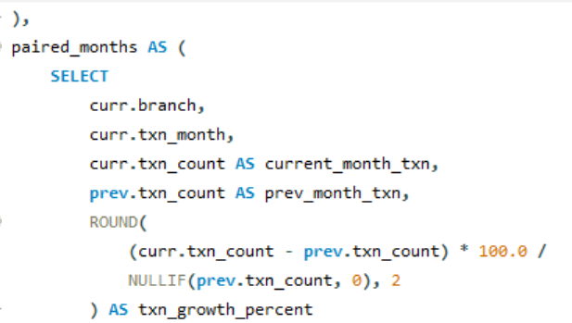
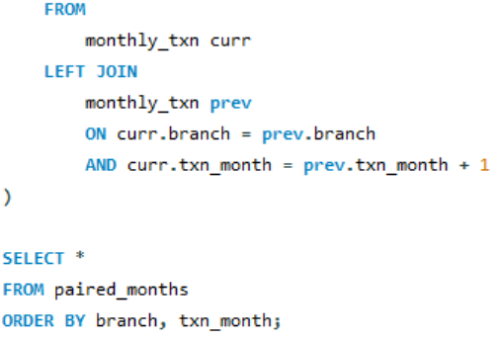

Slide 28
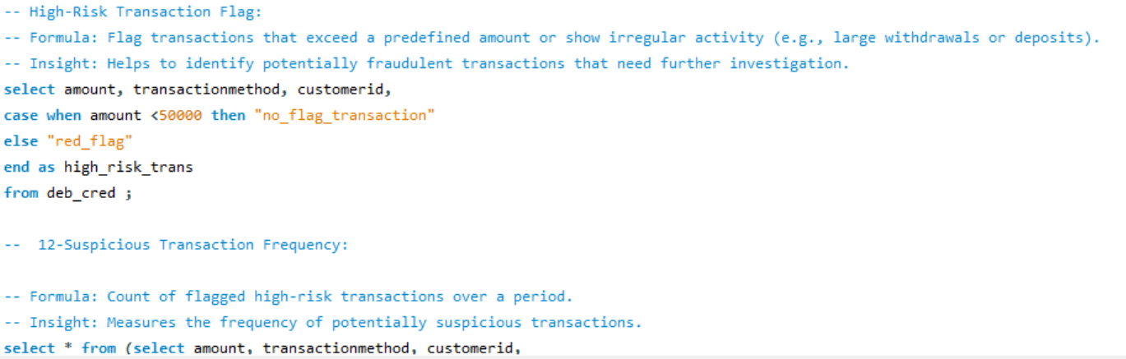
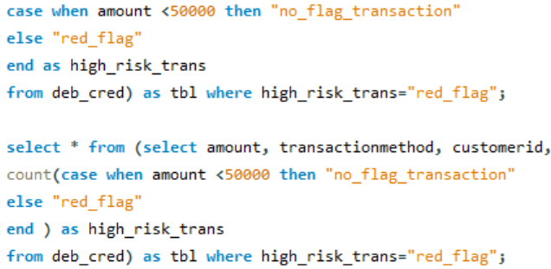

Slide 29
Recommendation 1
To Take loan amount we have to reduce loan processing unit & Loan amount.
With out profile verification the loan amount will not provide.
While processing Loan bank’s has to put the income limitation for salaried /Business man.
The bank field officer need to observe the Loan re-paying or not for all types of Grades.
While providing Loans Age limit need to be check.
6. Banker has to encourage Agriculture loan’s with less interest.
While issuing the credit card banker need to verified there profile correctly.
Bankers are providing credit cards offers in Online but they have to provide debit card offers also.
Banking team need to introduce debit card rewards point also.
Bankers has to update auto limit based up on their profile.
Bankers has to reduce Annual fee so people will show interest to take credit & debit cards.

Slide 30
Conclusion
Bank need to understand the demographics of customers taking loans such as Age, Income Level, Occupation, and credit score.
This information can help the bank design targeted loan products and marketing strategies.
By analyzing the most common purposes form which customers are taking loans like home loan, car loan, education ,personal loan etc. This helps to understand customer needs, accordingly bank can offer the loan products.
By examine the rang of interest rates and loan terms offered to customers, bank can provide insights into the competitiveness of the loan offerings and how they compare with other financial institutions.
Accurate business decisions are made and can track the business state. It enables a holistic view of the business, supporting loan-Terms growth and competitiveness in the banking industry.

Slide 31
THANK YOU

